Slide 1

THE SHOPPING WIZARD
THE SHOPPING WIZARD
Alfonso García de la Santa - Álvaro Merino - Hayk Petrosyan - Oriol Alfambra

Slide 2
LEARNED LESSONS:
Use of flexbox
Use of template to display the pages
Control functions on buttons
Use of git
Team Working

Slide 3
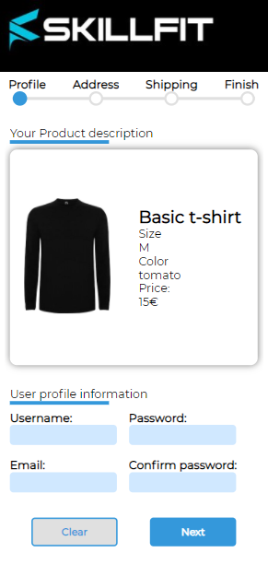
FLEXBOX:
LESSON LEARNED Handling Position Align Inheritance | PROBLEMS Skeleton structure Responsive Css to generic tags

Slide 4
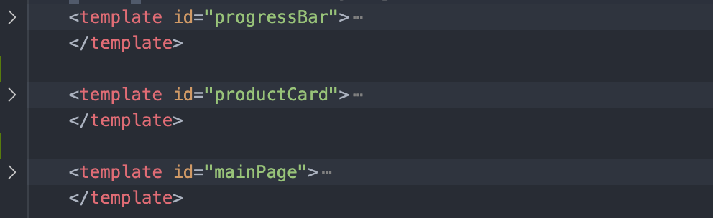
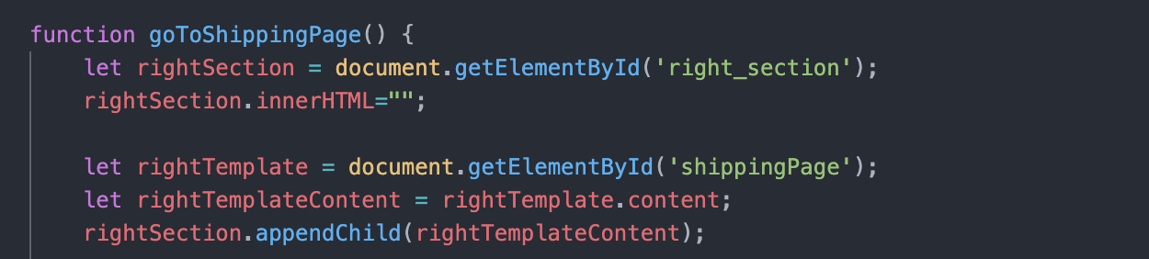
TEMPLATE TO DISPLAY THE PAGES:
LESSON LEARNED Function distribution Template managing DOM Elements Hierarchy Elements allocation | PROBLEMS Managing variables and functions scopes remove() & firstChildNode Elements collision

Slide 5
CONTROL FUNCTION ON BUTTONS:
LESSONS LEARNED Handling events PreventDefault Changing elements relation Relate page transitions with functions triggering | PROBLEMS Managing execution flow redirections Automated functions triggering Conflicts using keywords

Slide 6
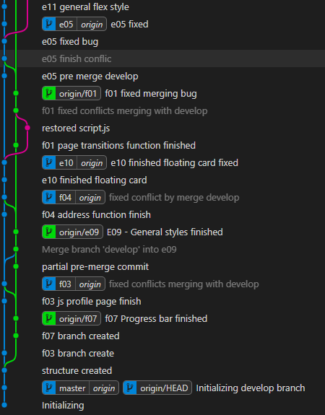
GIT:
LESSON LEARNED Check that we are in the correct branch Select which fields to merge | PROBLEMS Merge

Slide 7
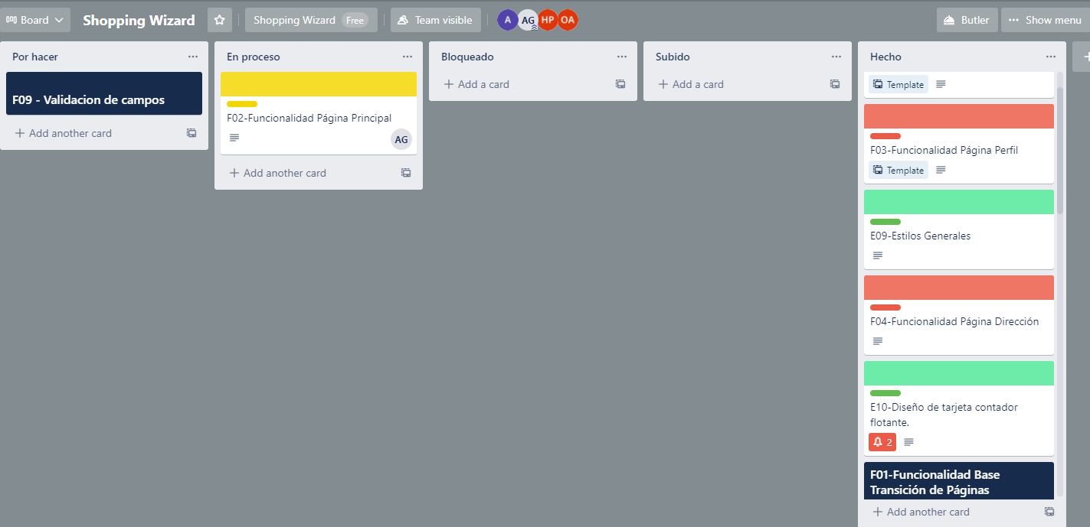
TEAM WORKING:
LESSON LEARNED Scrum like methodology Trello Methodology profit | PROBLEMS Managing Tasks scope. Blocker tasks. Built from scratch team

